Slide 1
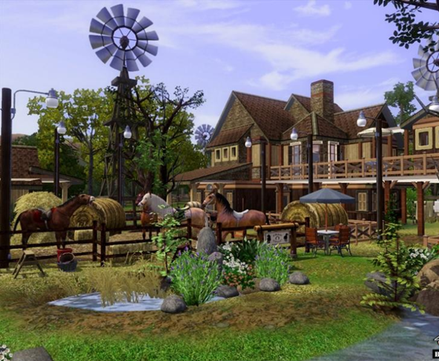
The Pet Farmer Killer
Game programming
Creator: Moise mokoy

Slide 2
Why I decide to change
Game design
Source
Time

Slide 3
New Game Concepts
The pet-farmer Killer is a survivor action game. The game is about a farmer who in order to survive he has to kill the animals in his farm.
It’s a first person shooter
Two levels and a boss in each level

Slide 4
Game Idea
Farm Frenzy
Hunting
UFO

Slide 5
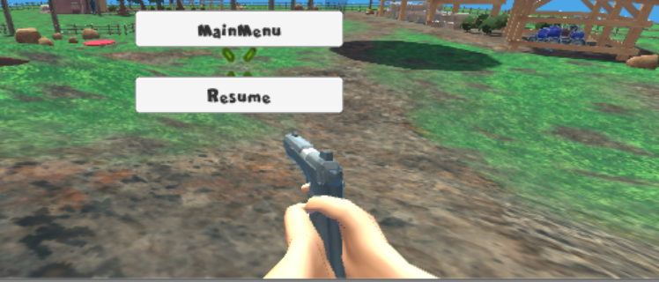
Character
First person shooter

Slide 6
Controller
Mouse Click to shoot
A, w, s, d to move forward and backward, left or right
Shift button to accelerate
Space button to jump
P to Pause the game

Slide 7
NPCS
Cow
Chicken
Sheep
Pig

Slide 8
Game Design and Mechanism
Objectives
Survive
Kill animal to gain point
Kill the boss to pass the level

Slide 9
Levels
This game has two levels
Level 1:
Daytime
Reach 5000 points to go to the next level
Two types of animals: Pig and Chicken
Can collect gun, munition, and lives(both level)
Level 2:
Night Time
Reach 5000 points to go to the next level

Slide 10
Scoring
Each time I kill an animal I get point.
Animals | Points
Chicken | 100
pig | 150
Cow | 300
Sheep | 350
Boss (sheep) | 1000

Slide 11
Objects
Guns
AK47,Rockets,Shotgun,handgun
Ammo
Lives
UFO

Slide 12
Artificial Intelligence
NavMeshAgent for navigation
AI animal control

Slide 13
Challenges
NavMesh Agent
Animation
UI
Scripting
Time

Slide 14
HUD
Enemy
Health
Score
Armor
Ammo

Slide 15
Demo

Slide 16
Future implementation
More levels
Improve animation
Transition between levels
Timer

